Slide 1
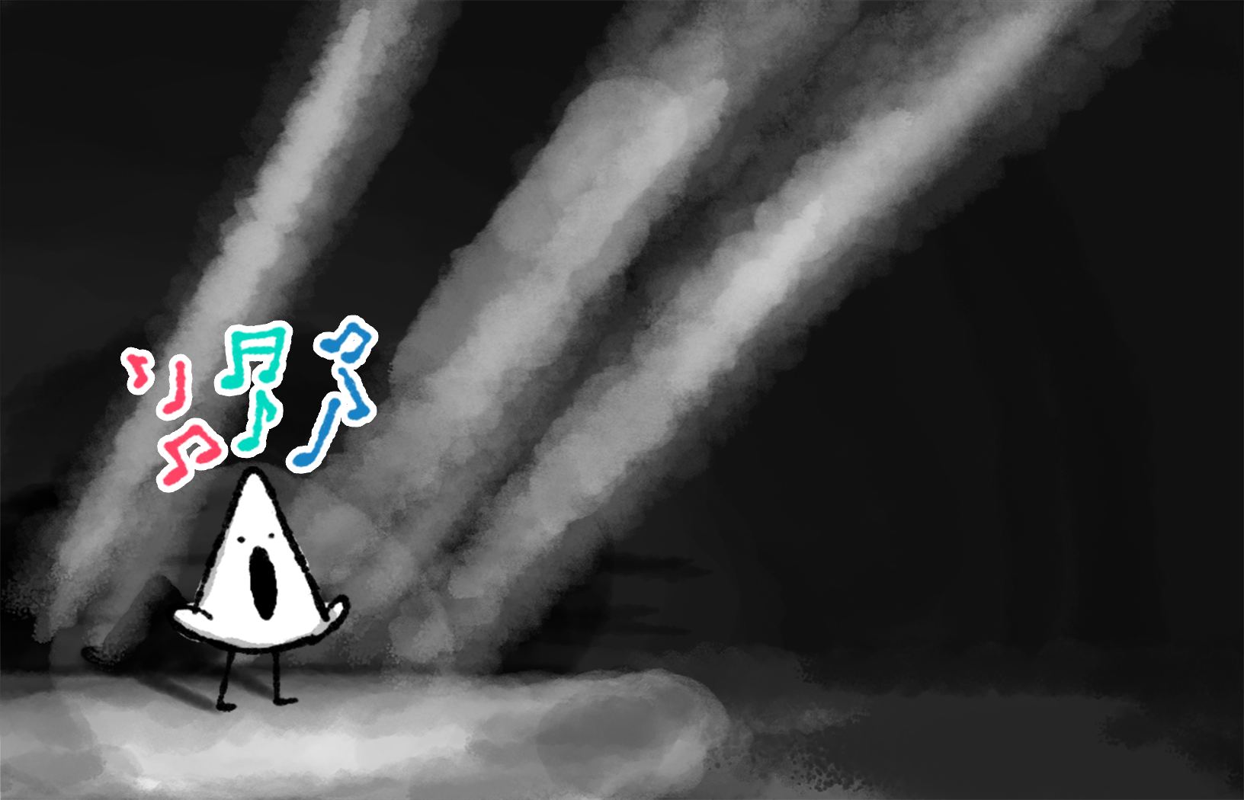
MOOD BOARD
Lullaby
Notes:
This expanded version of the document allows us to add our pictures, inspirations, ideas and thoughts on the project for us to discuss through on Monday. Any contribution is encouraged, including ones that contradict or diverge from what is already present on the board.
There are generally no rules, except to please put the games you reference into the list at the bottom, if you feel it can show us something interesting for our project. Each category can be expanded as needed with more pages.

Slide 2
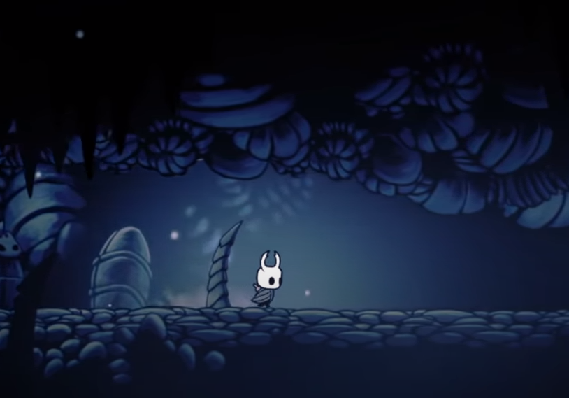
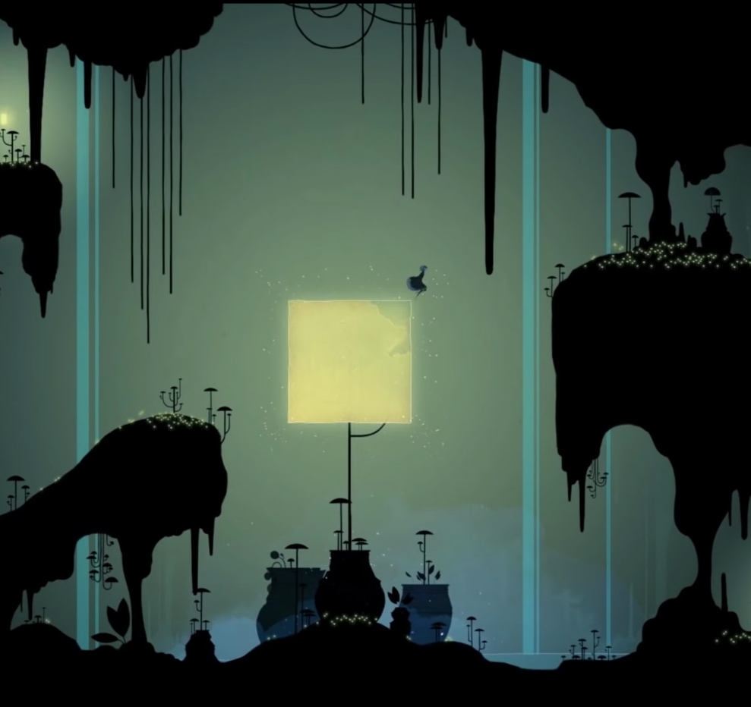
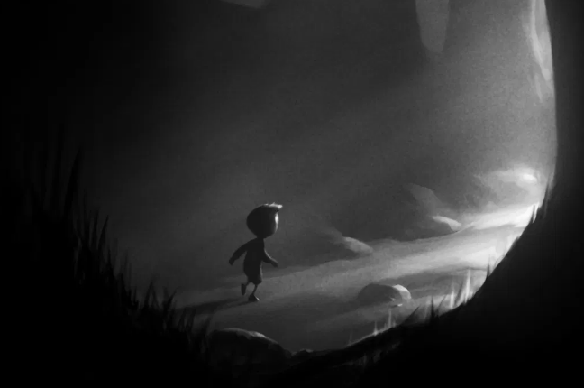
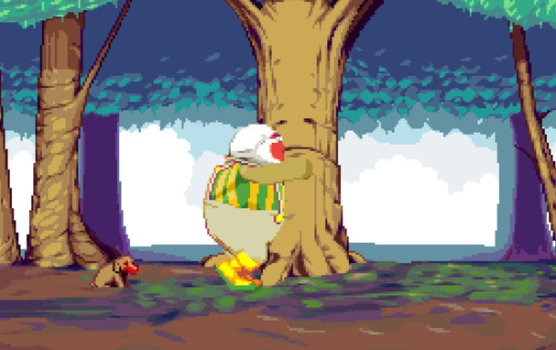
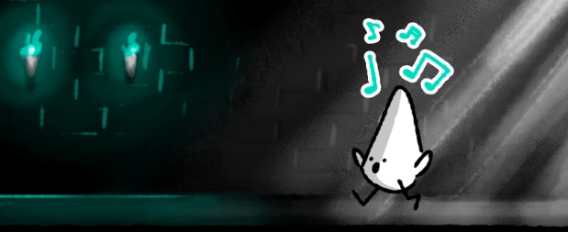
MOOD INSPIRATIONS
In Lullaby, the unassuming and cute nature of the main character is put in contrast to the otherwise moody and lonely atmosphere of the games setting, a dark dungeon. However, with their ability to sing, the main character is able to bring levity to the atmosphere by temporarily breathing life into the old mechanisms and debris of the dilapidated dungeon. - Monochromatic world, but song adds colour.

Slide 3
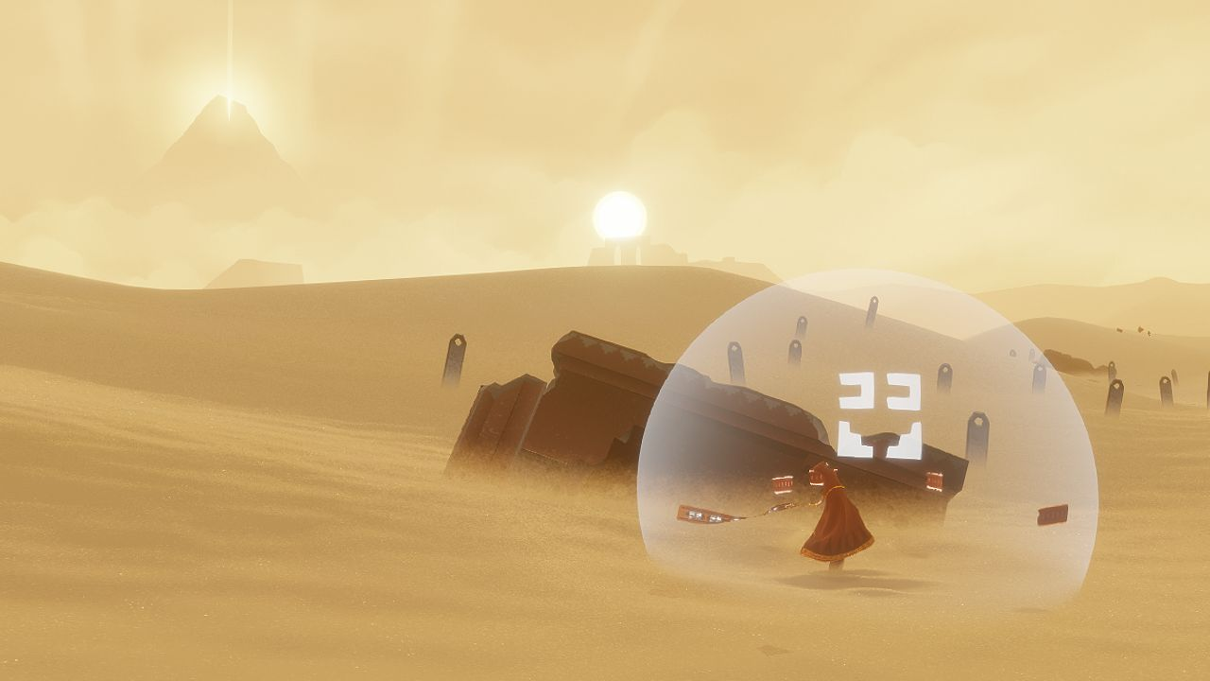
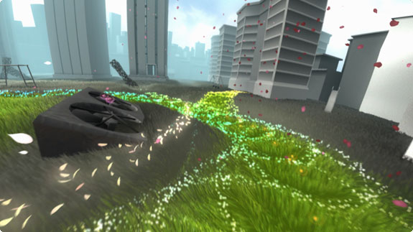
MOOD INSPIRATIONS CONT.
Feel free to add text boxes where you feel you would like to provide some clarifying text.
A journey may start out as a lonely and depressing venture given the context of the world. But through actions it may just take a turn for the better.

Slide 4
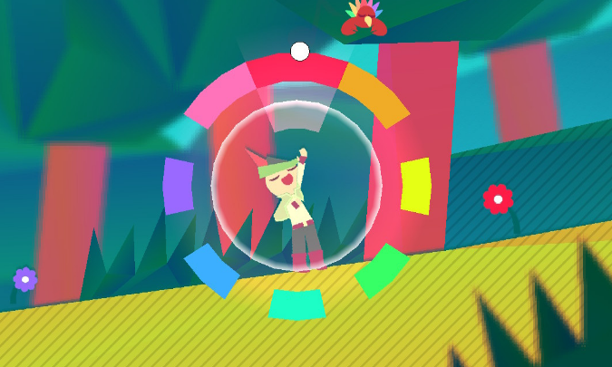
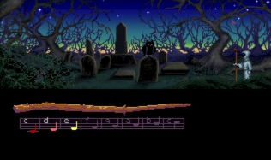
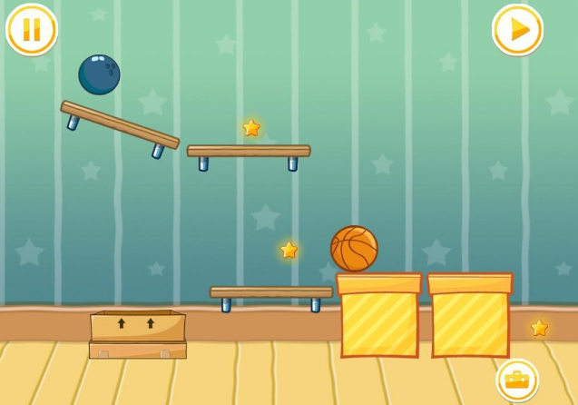
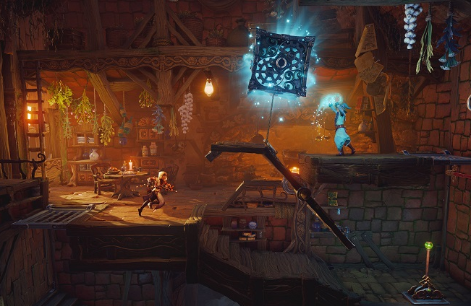
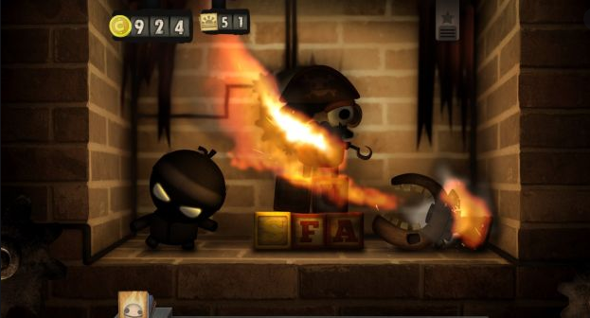
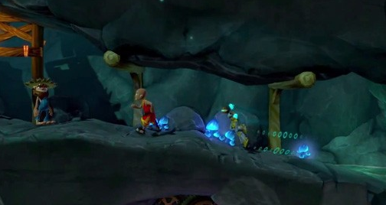
MECHANICAL INFLUENCES
Lullaby is a 2D game, which emphasises musicality and puzzles more so than complex platforming systems. The player progresses mainly through manipulating and engaging with the world through their musical abilities. An appeal of the game is observing and experimenting with the (sometimes unpredictable) systems of the world. I believe physics interactions may be an interesting way to add variety to the puzzle systems.

Slide 5
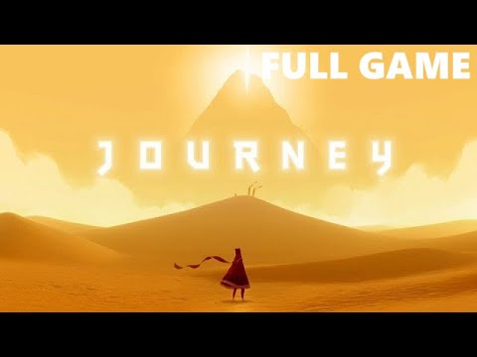
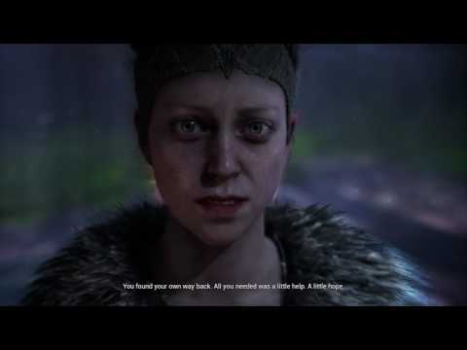
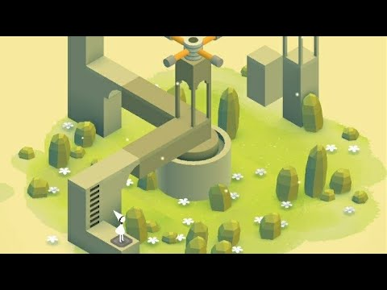
MECHANICAL INFLUENCES CONT.
Feel free to add text boxes where you feel you would like to provide some clarifying text.
Three different uses of audio in interacting with game and/or gameworld. Is any of them musical?

Slide 6
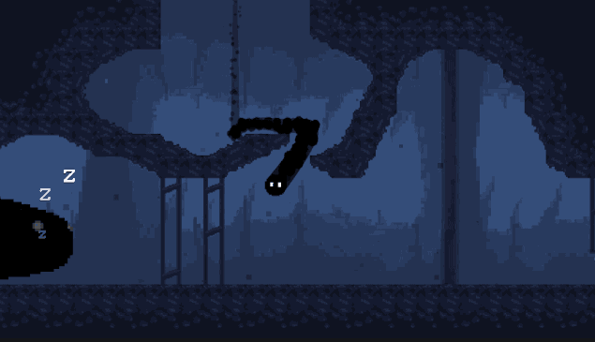
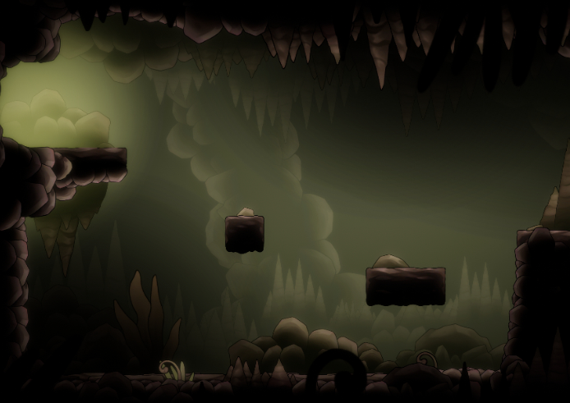
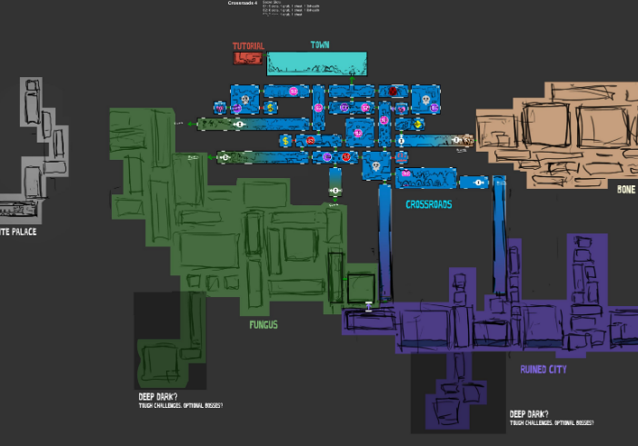
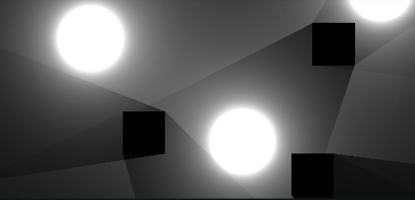
LOCATION
The game is set in a dim dungeon, which is littered with old objects and mechanisms which the character interacts with to progress. Making the dungeon branch in a Metroidvania style would allow the player to have a more interesting relationship with the environment than if it was strictly linear. The player could potentially acquire new skills/notes throughout the game.
The world of Lullaby is inherently musical, an aspect the main character is uniquely able to tap into, allowing them to manipulate the world. An example could be slowing the world down by lowering the world’s “tempo” with the music.

Slide 7
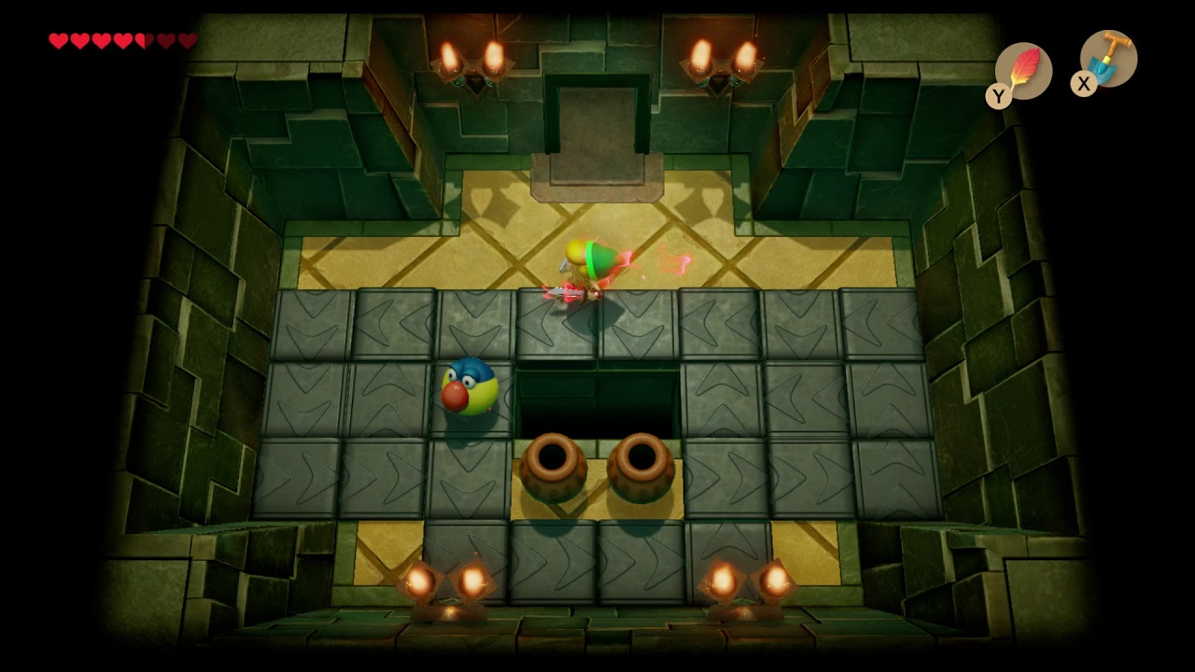
LOCATION CONT.
Feel free to add text boxes where you feel you would like to provide some clarifying text.

Slide 8

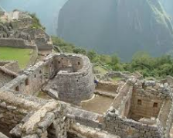
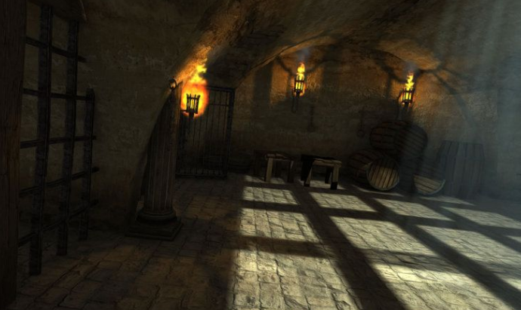
STORY AND FRAMING
The Resting Giant on which the world is built has begun to stir in their sleep. Whether they’re waking up or simply having a bad dream, the trembles caused by their movements signal an impending disaster for the world as you know it.
It is said that a precious civilization, one long since forgotten by time, had a melody which could soothe the restless sleeper.
You must journey into the ancient dungeon, filled with relics of the past, in order to recover the lost lullaby and let the giant rest once more.

Slide 9
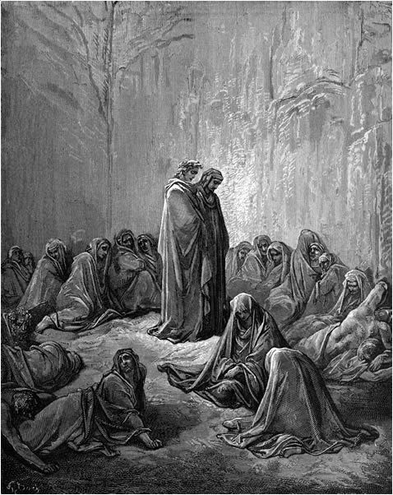
STORY AND FRAMING CONT
Feel free to add text boxes where you feel you would like to provide some clarifying text.
Silent as the grave. Inhabitants cannot find rest. They linger but without the music. There are only sounds left in the world to emphasize the hollowness.

Slide 10
Games referenced:
Dropsy - https://store.steampowered.com/app/274350/Dropsy/
A point and click game about spreading good vibes in an otherwise embittered world.
Flower - https://store.steampowered.com/app/966330/Flower/
A where you bring colour and flora to the concrete world playing as a flower petal
Gris - https://store.steampowered.com/app/683320/GRIS/
A 2D platformer featuring surreal environments and no threats.
Hellblade - https://store.steampowered.com/app/414340/Hellblade_Senuas_Sacrifice/
A narrative driven action game with emphasis on audio for sections of the game
Journey - https://store.steampowered.com/app/638230/Journey/
An emotive 3D platformer with distinct style and (para)-social gameplay
LIMBO - https://store.steampowered.com/app/48000/LIMBO/
A 2D platformer featuring a small character in a vast, dark world.
Little Inferno - https://store.steampowered.com/app/221260/Little_Inferno/
A physics-based game where players are encouraged to engage with various objects and explore how they interact with-and affect each other in surprising ways.
Loom - https://store.steampowered.com/app/32340/LOOM/
90’s point and click game where players play music with mouse presses in order to navigate the world.
Monument Valley - https://www.ustwogames.co.uk/games/monument-valley/
Puzzle game with Escher-style depictions of landscapes. Interaction is musical despite no formal instrument or need for musical virtuosity.

Slide 11
Games referenced Cont.:
The Cave - https://store.steampowered.com/app/221810/The_Cave/
A 2D puzzle platformer which emphasises solving puzzles with physics object interactions.
The Lengend of Zelda: Link’s Awakening - https://www.nintendo.com/games/detail/the-legend-of-zelda-links-awakening-switch/
Added because of top-down camera, dungeon crawling/puzzle-solving type of game
Trine 4 - https://store.steampowered.com/app/690640/Trine_4_The_Nightmare_Prince/
A 2D puzzle platformer - features a mage who can interact with objects rather uniquely.
Wandersong - https://store.steampowered.com/app/530320/Wandersong/
A musical 2D side scroller with a large emphasis on inventive use of music-and rhythm-based mechanics. Uses a selection wheel as a way to input musical notes.
Notes:
Here you can put games you’ve referenced + a short description of why you included it 😊

